Slide 1

FoodShare Connect
Food Donation and Distribution Management System
CSA4308-INTERNET PROGRAMMING
Faculty
Mr. Rajagopal K Dept. of CSE
SIMATS Engineering
TEAM
192365025 - K Sai Kumar
192365025 - Kongara Sai
192325046 - B Yogendra
192372262 - G Venkatesh Reddy
192372056 - H Sanjay Reddy

Slide 2


INTRODUCTION
Every year, large quantities of edible food are wasted by households, restaurants, and event organizers, while a significant number of people continue to face food insecurity. Bridging this gap has traditionally relied on informal networks and manual coordination between donors and welfare organizations, which is slow and difficult to scale. FoodShare Connect is a web-based platform designed to digitally connect food donors with NGOs, shelters, and individuals in need, streamlining the entire donation-to-distribution process.
Grows out of the need for a centralized, technology-driven food redistribution system
Connects donors, receivers (NGOs/individuals), and delivery volunteers on one platform
Encourages timely donation of surplus food before it becomes unusable
Supports the broader goal of reducing food waste and hunger in local communities

Slide 3
PROBLEM STATEMENT
No centralized platform exists for coordinating surplus food donations with people or organizations in need
Donors and NGOs rely on phone calls, word of mouth, or social media, leading to delays and missed donations
Lack of real-time visibility into what food is available, where, and how urgently it is needed
No structured process for verifying, approving, and tracking food requests
Delivery and pickup coordination is largely manual, causing spoilage and inefficiency
Absence of consolidated data/reports for monitoring impact and accountability

Slide 4
OBJECTIVES
Design a unified web platform connecting donors, receivers, and delivery volunteers
Enable donors to list surplus food with details such as quantity, type, and pickup window
Provide a request and approval workflow so receivers can claim available donations
Coordinate delivery logistics between donation and receiving points
Generate reports and analytics for administrators to monitor activity and impact

Slide 5
LITERATURE SURVEY
Year | Title / Focus Area | Objective | Limitation
2020 | Web-Based Food Donation Management System | Provide an online portal for restaurants to list surplus food for NGOs. | Limited to restaurant donors; no delivery coordination module.
2021 | IoT-Enabled Smart Food Rescue Platform | Use sensors to track food freshness and alert nearby NGOs. | High hardware cost; not scalable for individual donors.
2022 | Mobile Application for Surplus Food Redistribution | Connect individual donors with shelters via a mobile app. | No admin verification layer; risk of misuse.
2023 | Cloud-Based Food Bank Management System | Centralize inventory and requests for multiple food banks. | Focused on storage logistics; lacks real-time request approval.
2023 | GIS-Based Food Donation Routing System | Optimize delivery routes between donors and receivers. | Requires accurate live location data; limited in low-connectivity areas.
2024 | AI-Driven Demand Prediction for Food Banks | Predict food demand patterns to reduce shortages. | Needs large historical datasets; complex to deploy for small NGOs.
2024 | Blockchain-Based Transparent Donation Tracking | Ensure transparency and traceability of donated food. | High implementation complexity; limited donor familiarity with blockchain.

Slide 6
EXISTING SYSTEM AND ITS LIMITATIONS
Donors contact NGOs directly via phone or social media
NGOs manually track incoming donations on spreadsheets or registers
Pickup and delivery are arranged informally, often by volunteers on an ad-hoc basis
No shared visibility between multiple donors, NGOs, and volunteers
Slow response time increases the chance of food spoiling before pickup
No centralized record of donations, requests, or delivery status
Difficult to verify requester authenticity or prevent duplicate claims
No analytics to understand donation trends or unmet demand
Limited scalability beyond a small, local network of contacts
Existing Practice
Key Limitations

Slide 7
SYSTEM ARCHITECTURE DIAGRAM
Donor
Receiver (NGO)
Delivery Volunteer
Admin
Web / Mobile Interface
▼
▼
▼
▼
▼
Application Server — User Mgmt · Donation Mgmt · Request & Approval · Delivery Mgmt · Reports
▼
Database (Users · Donations · Requests · Deliveries)
The application server handles all business logic across the five modules and communicates with a central database that stores users, donations, requests, and delivery records.

Slide 8
PROPOSED METHODOLOGY
Frontend: HTML, CSS, JavaScript, React
Backend: Python
Database: MySQL
Development Tools: VS Code, GitHub
User Registration – Donors, receivers, and volunteers register and verify their accounts on the platform.
Food Donation Listing – Donors list surplus food with details such as type, quantity, and pickup window.
Request & Approval – Receivers browse listings and submit requests; admins or donors approve valid requests.
Delivery Coordination – A volunteer or delivery agent is assigned to pick up and deliver the approved donation.
Tracking & Reporting – Status updates are logged at each stage and consolidated into admin reports.

Slide 9
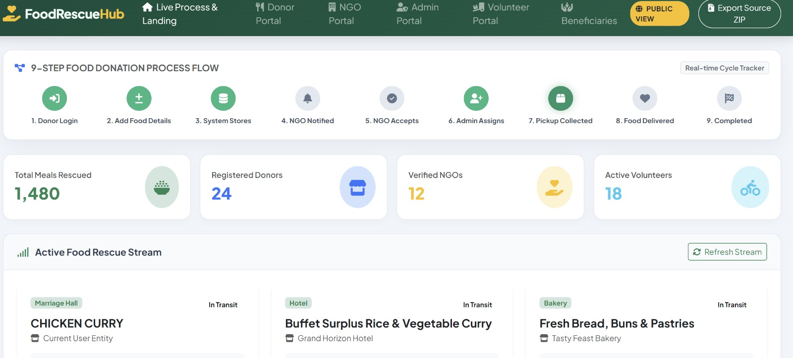

Slide 10
MODULE-WISE DESIGN
User Management – Registration, login, and role-based access for donors, receivers, volunteers, and admins.
Food Donation Management – Donors list surplus food with quantity, type, and pickup details.
Food Request & Approval – Receivers submit requests for listed donations; requests are reviewed and approved.
Delivery Management – Assigns volunteers to approved requests and tracks pickup-to-delivery status.
Admin & Reports – Central dashboard for monitoring activity and generating donation/distribution reports.

Slide 11
MODULE 1: USER MANAGEMENT
Allows donors, receivers, and delivery volunteers to create accounts and securely log in to the platform
Assigns role-based access so each user sees only the features relevant to them, such as donation listing for donors or approvals for admins
Stores and manages profile information, including name, contact number, address, and preferred pickup or delivery locations
Verifies user identity during registration to reduce fake accounts and build trust between donors and receivers
Lets users update their profile and track their donation or request history from a personal dashboard

Slide 12
MODULE 2: FOOD DONATION MANAGEMENT
Enables donors to create a donation listing by specifying food type, quantity, and condition (packaged, cooked, perishable, etc.)
Lets donors set an available pickup location and a suitable time window for collection
Allows donors to optionally attach photos of the food item so receivers know what is being offered
Automatically updates each listing's status as Available, Requested, or Completed as it moves through the workflow
Sends reminders to donors when a listed item is nearing its pickup deadline, helping reduce spoilage

Slide 13
MODULE 3: FOOD REQUEST & APPROVAL
Allows registered receivers to browse and filter currently available donation listings by food type or location
Enables a receiver to submit a request to claim a specific donation
Routes each request to the donor or admin for review, who can approve or reject it based on availability
Prevents duplicate claims by locking a listing once a request against it has been approved
Automatically forwards approved requests to the delivery management module for volunteer assignment

Slide 14
MODULE 4: DELIVERY MANAGEMENT
Assigns an available delivery volunteer to each approved food donation request
Provides volunteers with pickup and drop-off details, including donor and receiver addresses and contact information
Tracks the real-time status of every delivery, from assignment through pickup to final drop-off
Allows receivers to confirm successful delivery, which closes out the request in the system
Maintains a complete delivery history that can be reviewed later for performance tracking and reporting

Slide 15
MODULE 5: ADMIN & REPORTS
Provides administrators with a centralized dashboard to monitor all donations, requests, and deliveries in real time
Generates reports on donation volume, request approval rates, and delivery performance over selected time periods
Allows admins to manage user accounts, resolve disputes, and remove inactive or fraudulent listings
Highlights trends such as high-demand areas or frequently donated food types to support better planning
Supports data-driven decisions that help improve the overall efficiency and reach of the platform

Slide 16
CONCLUSION
FoodShare Connect addresses the persistent gap between surplus food and the people who need it by replacing informal, manual coordination with a structured digital platform. By bringing donors, receivers, delivery volunteers, and administrators onto a single system, the platform streamlines the entire donation lifecycle — from listing and approval to delivery and reporting. The role-based workflow ensures accountability at every stage, reducing delays, duplicate claims, and food spoilage that plague existing manual processes. Centralized reporting gives administrators real-time visibility into donation trends and distribution impact, enabling better planning and resource allocation. Overall, the system demonstrates how a simple, well-structured web platform can meaningfully reduce food wastage while improving access to food for those in need. With further development, FoodShare Connect can be extended into a scalable, community-wide solution for food security.

